Slide 1
LO: Write different types of sentences
SC: I can use adjectives and adverbs for effect
SC: I can use punctuation for effect

Slide 2
3 _ed
sentences
Frightened, terrified, confused, they ran from the creature.
Amused, amazed, excited, he left the circus reluctantly.
Confused, troubled, worried, she didn’t know what had happened.
These sentences are very good for showing us the emotional state of a character.

Slide 3
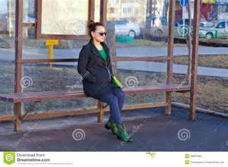
Write a 3 _ed sentence for this picture on your white board.

Slide 4
2 pairs
sentences
Exhausted and worried, cold and hungry, they did not know how much further they could go.
Injured and terrified, shocked and lost, he wandered aimlessly across the battlefield.
Angry and bewildered, numb and fearful, he couldn’t believe his eyes.

Slide 5
Write a 2 pair sentence for this picture on your white board.

Slide 6
double ly ending
sentences
He swam slowly and falteringly.
verb first adverb second adverb
He rode determinedly and swiftly.
He laughed heartily and loudly.
These are very precise sentences, adding detail.

Slide 7
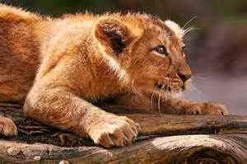
Write a double –ly sentence for this picture on your white board.

Slide 8
O. (I.) Outside : Inside
sentences
He laughed heartily at the joke he had just been told. (At the same time it would be true to say he was quite embarrassed).
She told the little girl not to be so naughty. (Inside, however, she was secretly amused by what she had done).
The first part of the sentence tells us what is happening on the OUTSIDE of the character. But the brackets tell us what the character’s true (INNER) feelings are.

Slide 9
Write an outside (inside) sentence for this picture on your white board.

Slide 10
De:De Description : Details
sentences
The vampire is a dreadful creature: it kills by sucking all the blood from its victims.
Snails are slow: they take hours to cross the shortest of distances.
I was exhausted: I hadn’t slept for more than two nights.
The first part is descriptive and then the second part adds detail.

Slide 11
Write a de:de sentence for this picture on your white board.

Slide 12
Task for next lesson : Write sentences about what Rose Blanche saw and how Rose Blanche felt, demonstrating your understanding of the different sentence styles.
Double -ly
3 _ed
Description:Detail
Outside (Inside)
2 pair sentences

